Slide 1
Introduction to Object-Oriented Program and Java Fundamentals
Dr. Phesto Namayala , 2024

Slide 2
Learning Objectives
At the end of this lecture, students must
Understand Object Oriented Programming Concepts, such as Abstraction, objects and classes, Encapsulation, Inheritance and Polymorphism
Student will learn concepts for implementing OOP in Java, Characteristics of Java, The Java Runtime Environment (JRE) , Java Source File, and Compilation.
Student will learn the fundamental Programming Structures in Java, such as Defining classes in Java, constructors, methods access, specifiers, static members, Comments, Data Types, Variables, Operators , Control Flow, Arrays , Packages, Java Doc and comments.

Slide 3
Introduction
Programmers write instructions in various programming languages to perform their computation tasks such as:
  Machine level Language
  Assembly level Language
  High level Language
Machine level Language: Machine code or machine language is a set of instructions executed directly by a Computer’s Central Processing unit (CPU).

Slide 4
Machine level Language
Each instruction performs a very specific task, such as a load, a jump, or an ALU operation on a unit of data in a CPU register or memory.
Every program directly executed by a CPU is made up of a series of such instructions.
Assembly level Language : is a low-level programming language for a computer, or other programmable device, in which there is a very strong (generally one-to-one) correspondence between the language and the architecture's machine code instructions.

Slide 5
Assembly Language
Assembly language is converted into executable machine code by a utility program referred to as an assembler; the conversion process is referred to as assembly, or assembling the code.
High level Language : is any programming language that enables development of a program in much simpler programming context and is generally independent of the computer's hardware architecture.

Slide 6
High-level language
High-level language has a higher level of abstraction from the computer, and focuses more on the programming logic rather than the underlying hardware components such as memory addressing and register utilization.
The first high-level programming languages were designed in the 1950s. Now there are dozens of different languages, including Ada , Algol, BASIC, COBOL, C, C++, JAVA, FORTRAN, LISP, Pascal, and Prolog.

Slide 7
High-level language
Such languages are considered high-level because they are closer to human languages and farther from machine languages. In contrast, assembly languages are considered low- level because they are very close to machine languages.
The high-level programming languages are broadly categorized in to two categories: Procedure oriented programming(POP) language and Object oriented programming (OOP) language.

Slide 8
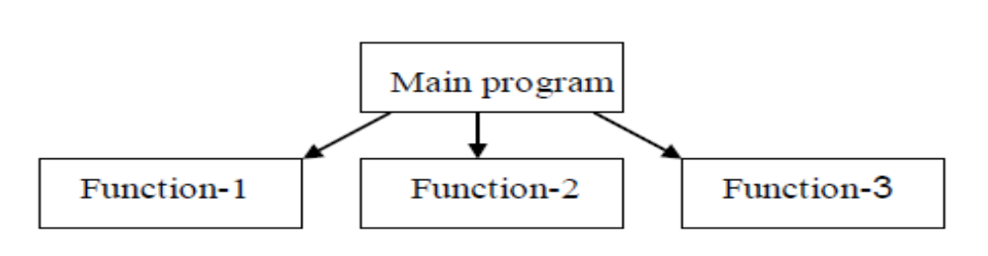
Procedure Oriented Programming Language
In the procedure oriented approach, the problem is viewed as sequence of things to be done such as reading , calculation and printing.
Procedure oriented programming basically consist of writing a list of instruction or actions for the computer to follow and organizing these instruction into groups known as functions

Slide 9
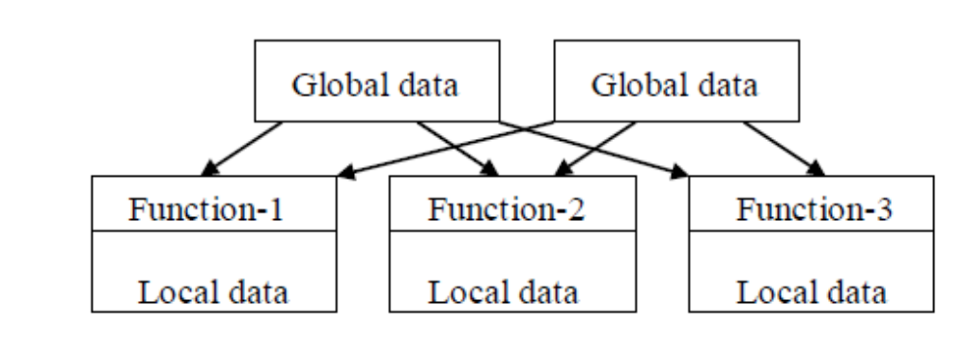
Procedure Oriented Programming Language..
The disadvantage of the procedure oriented programming languages is include:
  Global data access
  It does not model real word problem very well
  No data hiding

Slide 10
Characteristics of procedure oriented programming
Emphasis is on doing things(algorithm)
Large programs are divided into smaller programs known as functions.
Most of the functions share global data
Data move openly around the system from function to function
Function transforms data from one form to another.
Employs top-down approach in program design

Slide 11
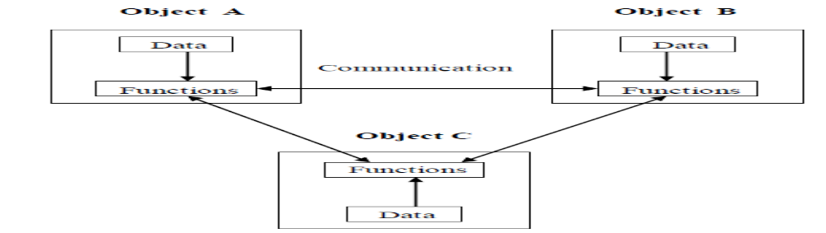
Object Oriented Programming
Object Oriented Programming (OOP) is a programming language model organized around objects rather than actions and data.
An object - oriented program can be characterized as data controlling access to code.
It is as an approach that provides a way of modularizing programs by creating partitioned memory area for both data and functions that can be used as templates for creating copies of such modules on demand.

Slide 12
Features of the Object Oriented programming
Emphasis is on doing rather than procedure.
programs are divided into what are known as objects.
Data structures are designed such that they characterize the objects.
Functions that operate on the data of an object are tied together in the data structure.
Data is hidden and can’t be accessed by external functions.
Objects may communicate with each other through functions.
New data and functions can be easily added.
Follows bottom-up approach in program design

Slide 13
OOP Vs. Procedural Programming
Procedure-Oriented Programming | Object-Oriented Programming
program is divided into small parts called functions | program is divided into parts called objects.
Importance is not given to data but to functions as well as sequence of actions to be done | Importance is given to data rather than procedures or functions because it works as a real world.
Follows Top Down approach | Follows Bottom Up Approach
Does not have any access specifier | Has access specifiers named Public, Private, Protected, etc
Data can move freely from function to function in the system. | Objects can move and communicate with each other through member functions.
It is not easy to add new data and functions | Provides an easy way to add new data and functions
Most function uses Global data for sharing that can be accessed freely from function to function in the system. | data can not move easily from function to function, it can be kept public or private so we can control the access of data.

Slide 14
OOP Vs. Procedural Programming..
Procedure-Oriented Programming | Object-Oriented Programming
Does not have any proper way for hiding data so it is less secure | Provides Data Hiding so provides more security.
Overloading is not possible | Overloading is possible in the form of Function Overloading and Operator Overloading
Examples of procedural programming languages include C, VB, FORTRAN, Pascal. | Examples of Object oriented programming languages include C++, Python and Java

Slide 15
Basic Concepts of OOP
Objects
Classes
Inheritance
Polymorphism
Abstraction
Encapsulation

Slide 16
Objects
Object means a real word entity such as pen, chair, table etc. Generally, Any entity that has state and behavior is known as an object.
Object can be defined as an instance of a class. It contains an address and takes up some space in memory.
Objects can communicate without knowing details of each other's data or code, the only necessary thing is that the type of message accepted and type of response returned by the objects
An object has three characteristics: State, Behavior and Identity.

Slide 17
Objects…
State: represents data (value) of an object.
Behaviour: represents the behavior (functionality) of an object such as deposit, withdraw etc.
Identity: Object identity is typically implemented via a unique ID. The value of the ID is not visible to the external user. But, it is used internally by the Java Virtual Machine (JVM) to identify each object uniquely.

Slide 18
Objects..
For example: consider an example named Amit; Amit is a male with 25 years old and his salary is 2500.
The Amit may be represented in a computer program as an object.
The data part of the object would be (name: Amit, gender: male age: 25, salary: 2500)
In the Amit object the name, gender, age and salary are called attributes of the object.
The program part of the object may be collection of programs (retrieval of data, change age, change of salary).

Slide 19
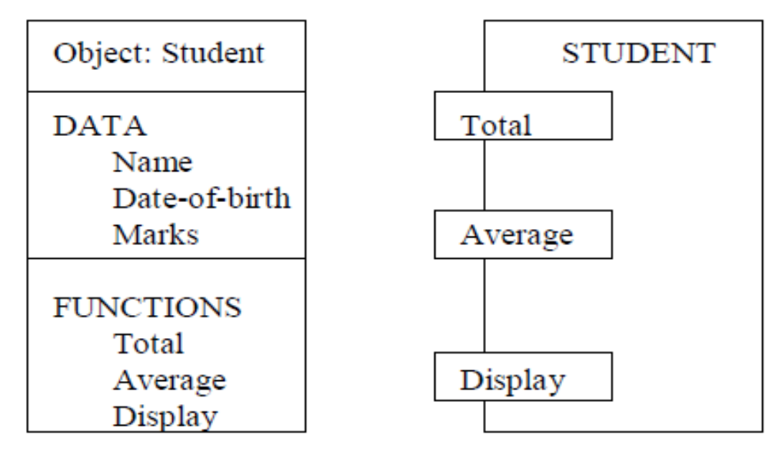
Objects..
In general even any user –defined type-such as employee may be used.

Slide 20
Class
A group of objects that share common properties for data part and some program part are collectively called as class.
A class can also be defined as a blueprint from which you can create an individual object.
A class consists of Data members and methods.
The primary purpose of a class is to hold data/information.
The member functions determine the behavior of the class, i.e. provide a definition for supporting various operations on data held in the form of an object.

Slide 21
Class..
Class doesn’t store any space because It just create a template and does not create an actual object.
Class create the new data type that is used to create objects.
Before creating class and objects we need to understand the structure of writing JAVA programs.
Thus, we will e revisiting on how to create classes and objects using JAVA.

Slide 22
INHERITANCE
Is the procedure or mechanism of acquiring all the properties and behavior of one class to another, i.e., acquiring the properties and behavior of child class from the parent class.
When one object acquires all the properties and behaviours of another object , it is known as inheritance .
It provides code reusability and establishes relationships between different classes.
A class which inherits the properties is known as Child Class(sub-class or derived class) whereas a class whose properties are inherited is known as Parent class(super -class or base class).

Slide 23
INHERITANCE..
Java supports single, multilevel and hierarchical inheritance.

Slide 24
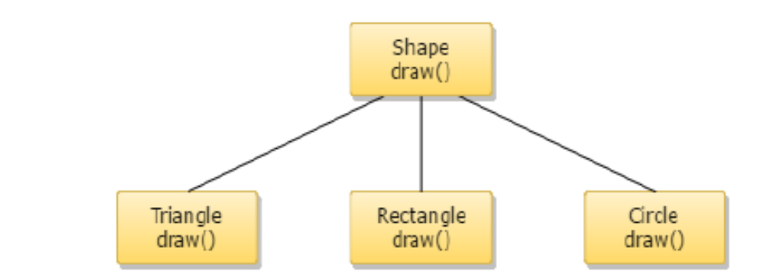
POLYMORPHISM
Occurs when one task is performed by different ways. For example, when convincing customers differently to draw something e.g. shape or rectangle etc.

Slide 25
POLYMORPHISM..
Polymorphism is classified into two ways: Method Overloading (Compile time Polymorphism) and Method Overriding(Run time Polymorphism)
Method Overloading is a feature that allows a class to have two or more methods having the same name but the arguments passed to the methods are different.
Compile time polymorphism refers to a process in which a call to an overloaded method is resolved at compile time rather than at run time.

Slide 26
POLYMORPHISM..
If subclass (child class) has the same method as declared in the parent class, it is known as method overriding in java.
In other words, If subclass provides the specific implementation of the method that has been provided by one of its parent class, it is known as method overriding.

Slide 27
Abstraction
Abstraction refers to the act of representing essential features without including the back ground details or explanations.
Abstraction is a process of hiding the implementation details and showing only functionality to the user. For example: phone call, we don't know the internal processing.
In java, we use abstract class and interface to achieve abstraction. This will be discussed later

Slide 28
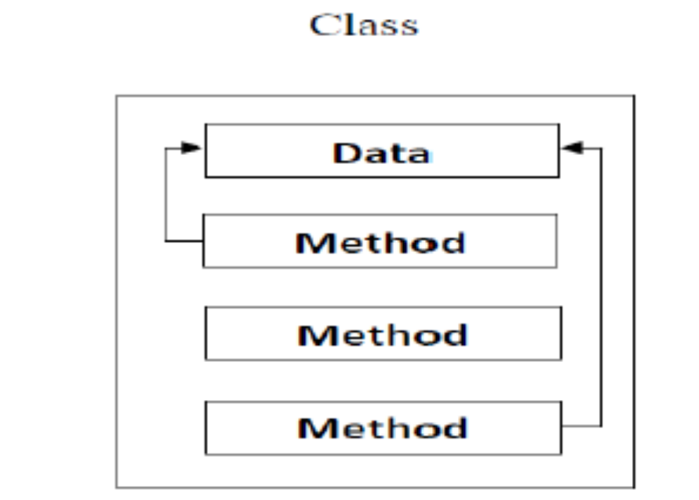
Encapsulation
Encapsulation in java is a process of wrapping code and data together into a single unit, for example capsule i.e. mixed of several medicines.
A java class is the example of encapsulation.

Slide 29
FEATURES OF JAVA
The features of Java are also known as java buzzwords.
Java is divide into java application and applets
Java is simple , clean and easy to understand. Its syntax is based on C++.
Java is also OOP, platform independent it only need JRE , secured because no explicit pointers and run inside virtual machine sandbox, robust, architecture neutral, portable, high performance, distributed, multi-threaded, and Dynamic.

Slide 30
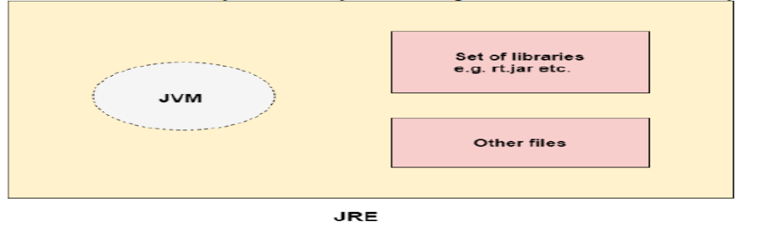
JAVA Environment
JRE
JRE is an acronym for Java Runtime Environment. It is also written as Java RTE.
It is the set of of software tools which are used for developing java applications.
JRE contains set of libraries and other files that JAVA Virtual Machine (JVM) uses at runtime

Slide 31
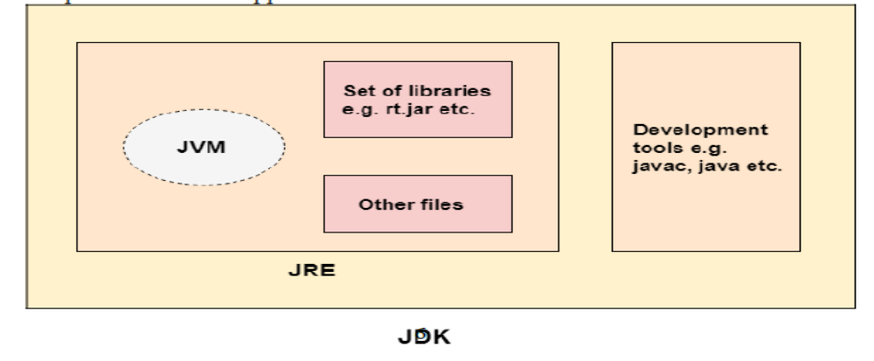
JAVA Environment..
(2). JDK
JDK is an acronym for Java Development Kit which is a software development environment which is used to develop java applications and applets.
It contains JRE and development tools, including a private Java Virtual Machine (JVM) and a few other resources such as an interpreter/loader (Java), a compiler (javac), an archiver (jar), a documentation generator (Javadoc)

Slide 32
The first program in Java
class Simple {
public static void main(String args[])
{
System.out.println("Java World");
}
}

Slide 33
The first program in Java
class keyword is used to declare a class in java.
public keyword is an access modifier which represents visibility, it means it is visible to all.
static is a keyword, if we declare any method as static, it is known as static method.
The core advantage of static method is that there is no need to create object to invoke the static method.
The main method is executed by the JVM, so it doesn't require to create object to invoke the main method. So it saves memory.
void is the return type of the method, it means it doesn't return any value.
main represents the starting point of the program.
String[] args is used for command line argument.
System.out.println() is used print statement.

Slide 34
The first program in Java
Java source code are saved with the class name. You need to note that if the source code is saved with the name different from the class name it cannot e compiled.
We normally use javac command to compile .java file and form .class file
The result of the JAVA compiler is the .class file or the bytecode and not the machine native code (unlike C compiler)
The bytecode generated is a non-executable code and needs an interpreter to execute on a machine

Slide 35
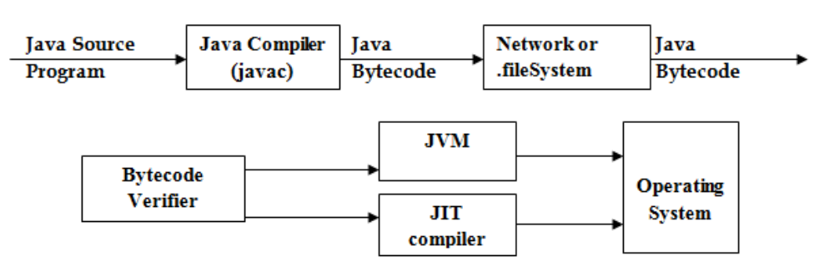
The first program in Java
This interpreter is the JVM and thus the Bytecode is executed by the JVM.
Finally, To run the compiled program we use a command “java” to give the desired outputs.

Slide 36
Defining Classes in JAVA
A class is declared by use of the class keyword
Syntax:
class classname {
type instance-variable1;
type instance-variable2;
// ...
type instance-variableN;
type methodname1(
parameter-list) {
// body of method
}
...
type methodnameN(
parameter-list) {
//
body of method }

Slide 37
Defining Classes in JAVA..
The data, or variables, defined within a class are called instance variables
The code is contained within methods
The methods and variables defined within a class are called members of the class.
In most classes, the instance variables are acted upon and accessed by the methods defined for that class.
Variables defined within a class are called instance variables because each instance of
the class (that is, each object of the class) contains its own copy of these variables. Thus, the data for one object is separate and unique from the data for another

Slide 38
Creating an object from class using Java
To create object we use the new operator.
The new operator dynamically allocates (that is, allocates at run time) memory for an object and returns a reference to it.
This reference is then stored in the variable. Thus, in Java, all class objects must be dynamically allocated.

Slide 39
Example of class and Object
Below simple class, create a Class called Box that defines three instance variables: width, height, and depth.
class Box {
double width;
double height;
double depth; }
The new data type is called Box. This name is used to declare objects of type Box

Slide 40
To create Box Objects
Box mybox = new Box(); // create a Box object called mybox
mybox will be an instance of Box.
Each time you create an instance of a class, you are creating an object that contains its own copy of each instance variable defined by the class.
To access these variables, you will use the dot (.) operator.
The dot operator links the name of the object with the name of an instance variable
.

Slide 41

Create object
class Box {
double width;
double height;
double depth;
}
// This class declares an object of type Box.
class BoxDemo {
public static void main(String args[]) {
Box mybox = new Box();
double vol;
// assign values to mybox's instance variables
mybox.width = 10;
mybox.height = 20;
mybox.depth = 15;
// compute volume of box
vol = mybox.width * mybox.height * mybox.depth;
System.out.println("Volume is " + vol);
}
}

Slide 42
Create Multiple objects
You can create multiple objects, such as mybox1 and mybox2 from the single class Box.
Try it for yourself!

Slide 43
Examples of multiple boxes
// This program declares two Box objects.
class Box {
double width;
double height;
double depth;
}
class BoxDemo2 {
public static void main(String args[]) {
Box mybox1 = new Box();
Box mybox2 = new Box();
double vol;
// assign values to mybox1's instance variables
mybox1.width = 10;
mybox1.height = 20;
mybox1.depth = 15;
/* assign different values to mybox2's
instance variables */
mybox2.width = 3;
mybox2.height = 6;
mybox2.depth = 9;
// compute volume of f
irst box
vol = mybox1.width * mybox1.height * mybox1.depth;
System.out.println("Volume is " + vol);
// compute volume of second box
vol = mybox2.width * mybox2.height * mybox2.depth;
System.out.println("Volume is " + vol);
}
}

